Slide 1
FPS INVENTORY: WebPAge Prototypes

Slide 2


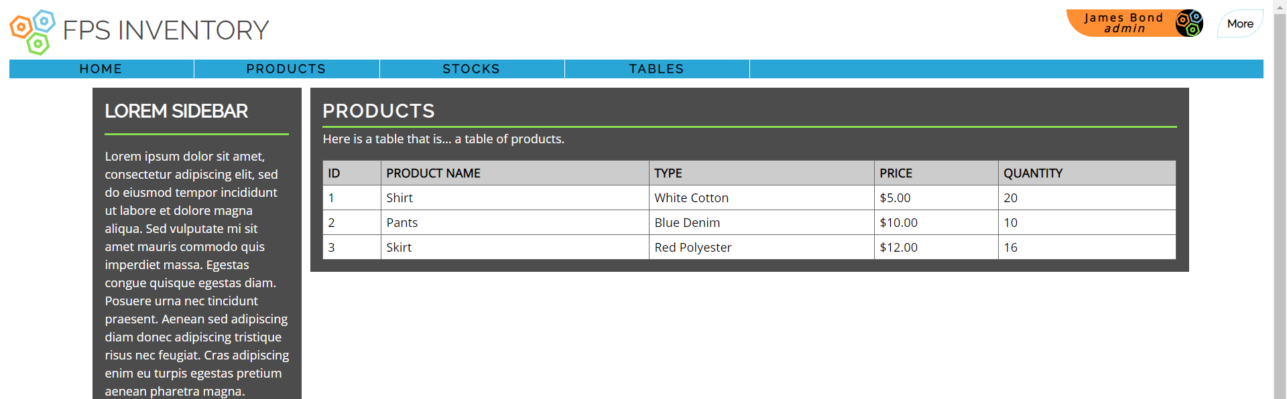
Products Table

Slide 3
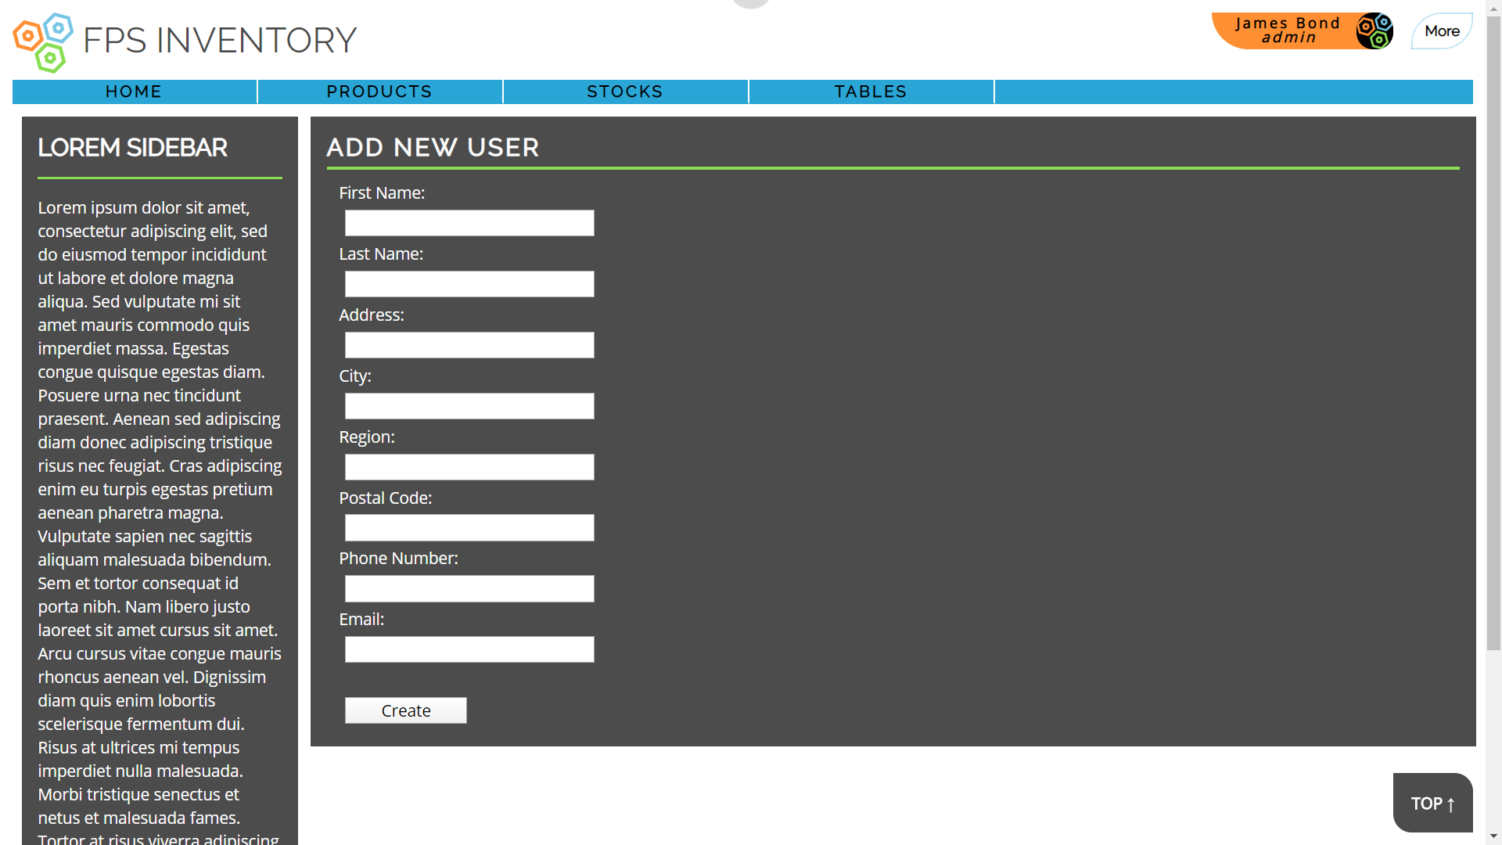

Slide 4
